Slide 1
AI-Powered-Dynamic-Chatbot-with-AI-Assistance-Live-Chat

Slide 2
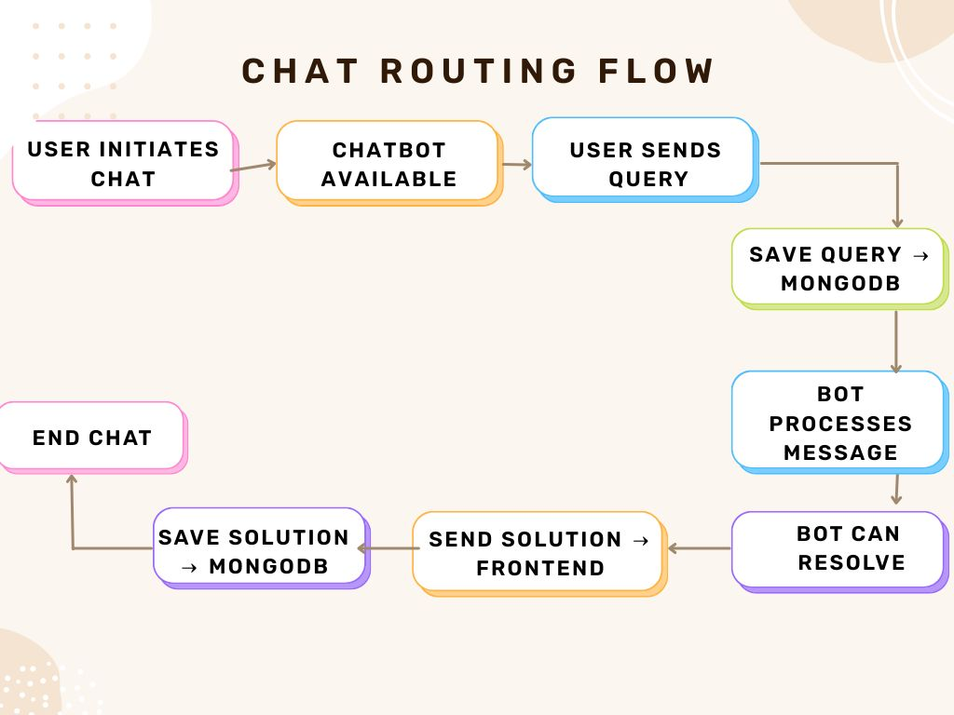
CHAT ROUTING FLOW
Chat Routing Flow (Compact)
User initiates chat.
Chatbot confirms availability.
User sends a query.
Query is saved to MongoDB.
Bot processes the message.
If resolvable, bot prepares a
response.
Solution is sent to the frontend.
Solution is also saved in MongoDB.
Chat session ends.

Slide 3
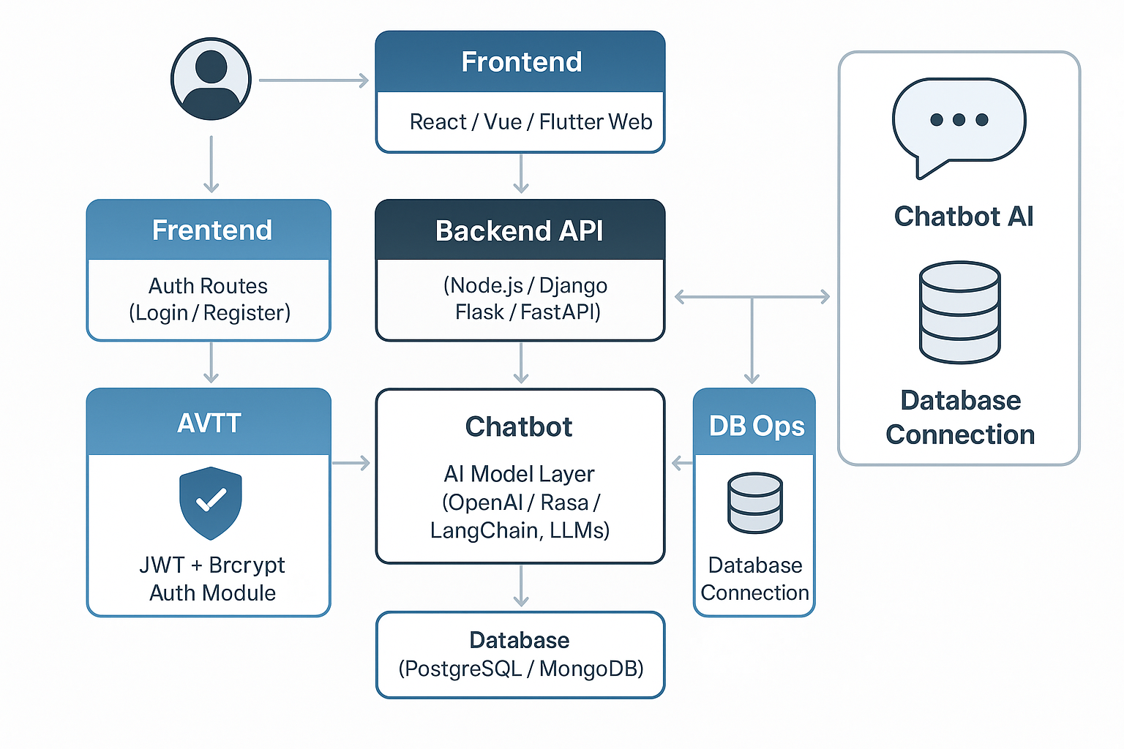
THE SYSTEM ARCHITECTURE
Users access the system via web or mobile apps, built using modern frontend frameworks like React, Vue, or Flutter Web.
Authentication flows handle login and registration, returning JWT tokens that authenticate users in future requests.
The frontend has a chat interface that allows users to send messages to the bot and receive intelligent responses.
The backend API processes requests using a REST or GraphQL setup, written in frameworks like Node.js, Django, or FastAPI.
Authentication is handled with JWT and Bcrypt, ensuring secure user identity verification.
The AI layer connects to LLMs like OpenAI, Rasa, or Langchain, and responses are logged or stored in a database such as PostgreSQL or MongoDB.

